Slide 1
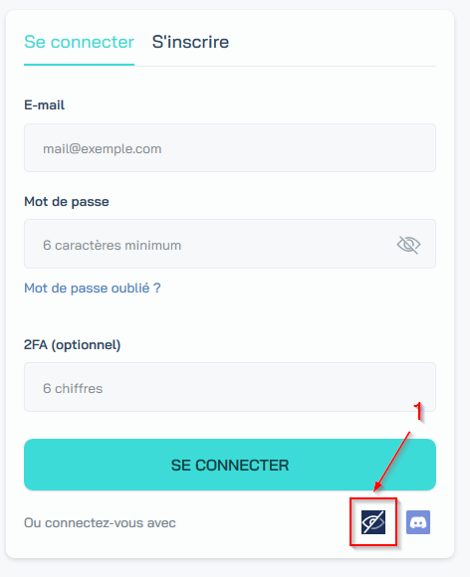
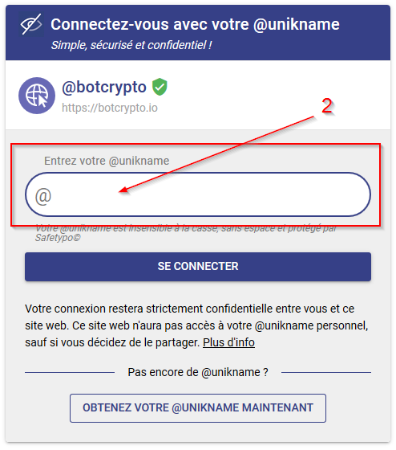
On any Website, embedding the Unikname Connect button:

Slide 2
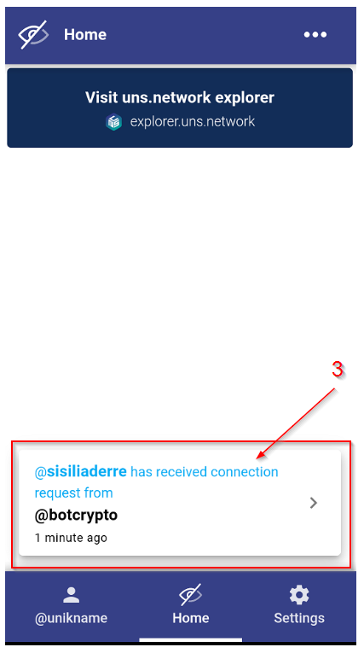
From the Unikname app, on your smartphone:

